Slide 1
Optiply {
cover.html
contents.css
[Front-end Developer]
< Intern: Ricardo Marques Oliveira >
< Supervisor at company: Fábio Belga >
< Supervisor at department: Prof. José Saias >
}

Slide 2
Table Of ‘Contents’ {
01
02
03
cover.html
contents.css
Introduction
Corporate environment
Development environment
04
Work performed
05
Critical review
}

Slide 3
01 {
[Introduction]
intro.html
corp-env.html
< Activity performed >
< Technologies used >
< Methods applied >
}

Slide 4
02 {
[Corporate Environment]
intro.html
corp-env.html
< About Optiply >
< Team Structure >
< Infrastructures and Environment >
}

Slide 5
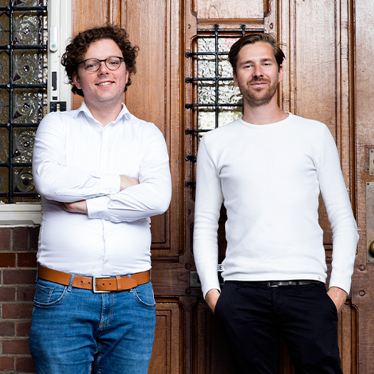
About Optiply {
corp-env.html
optiply.html
Optiply was founded in 2015 by Wiebe Konter and Sander van den Broek in the Netherlands.
50+ professionals
4 countries
Supply Chain service provided to third party companies
“Optimise your supply”
}

Slide 6
The Team Structure {
optiply.html
team-struct.css
Front-end Developers
Integrations
Back-end Developers
Technical support
}

Slide 7
Infrastructures and Environment {
team-struct.css
inf-env.html
<img src=“optiply-environment.png” alt=“Infrastructures
& Environment” width=“300” height=“300”>
}

Slide 8
03 {
[Development Environment]
dev-env.ts
hardware.html
< Hardware >
< Software >
< Working method >
}

Slide 9
Hardware < /1 > {
dev-env.ts
hardware.html
<p> The company did not supply any machine to the new interns. We used our own machine instead </p>
}
Peripherals < /2 > {
<p> Despite that fact, we could use any peripherals that the company has available at the head office. </p>
}

Slide 10








Software {
hardware.html
software.ts
}

Slide 11
Solo < /1 > {
software.ts
work-method.html
<p> At first, I started working by my self completing a course at Udemy. I also started the project by my own. </p>
}
Pair Programming < /2 > {
<p> At the latest stage we started working side by side at the previous project. </p>
}

Slide 12
04 {
[Work performed]
work-perf.html
course.html
< Udemy Course >
< Application Replica>
}

Slide 13
Theoretical < /1 > {
work-perf.html
course.html
<p> The course was based on video classes explaining the framework theoretically. </p>
}
Practical < /2 > {
<p> Beyond that the course had several minor projects which assisted to absorb the knowledge in practice. </p>
}

Slide 14
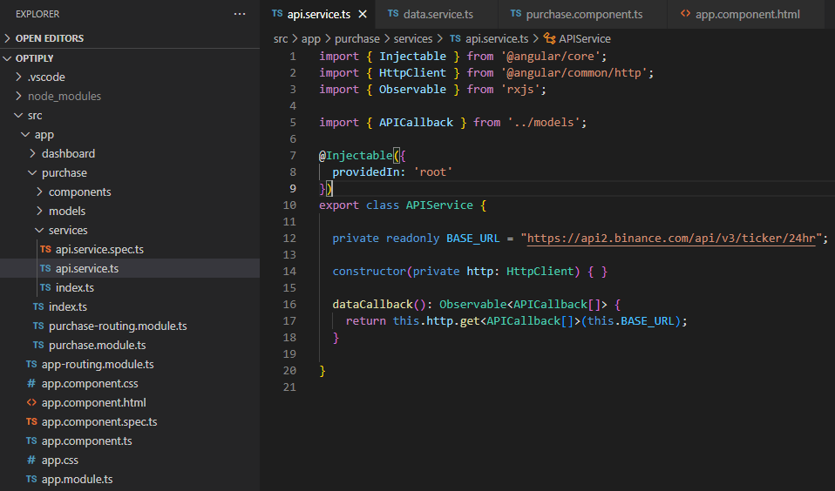
Application Replica {
course.html
optiply.ts
}

Slide 15
What Is this ‘Topic About ?’ {
forbeginners.html
workshop.css
Languages
Html
60%
Css
40%
< Mercury is the smallest planet in the entire Solar System >
< The Earth is the only one that harbors life in the Solar System >
Create a web page
Venus has a nice name
Mars is a cold place
Jupiter is a gas giant
}
Programming Language

Slide 16
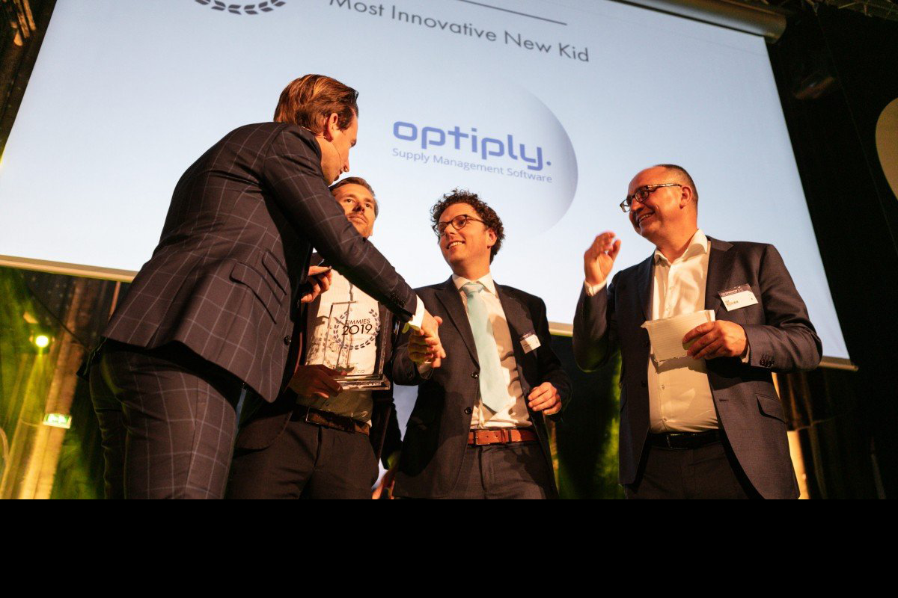
Critical Review { ? }

